Slide 1
Optimization for Training Deep Models
Regularization

Slide 2
Outline
Regularization Introduction
Introduction
Parameter Initializations
SGD and Momentum Adaptive Learning Rates
2 / 19

Slide 3
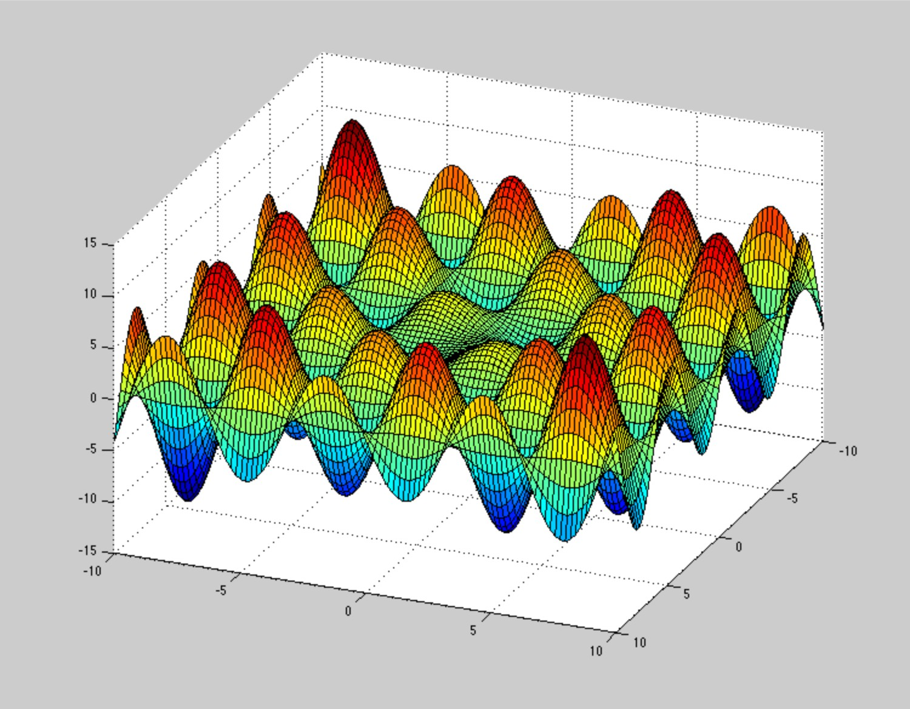
Non-convex Optimization
Regularization Introduction
Finding the parameters that yield the minimum cost
argmin L(f (x, θ), y )
(1)
ϴ
The cost functions of neural networks are highly non-convex
Figure 1: A non-convex function has multiple local optima, Source: imgur.com
2 / 19

Slide 4
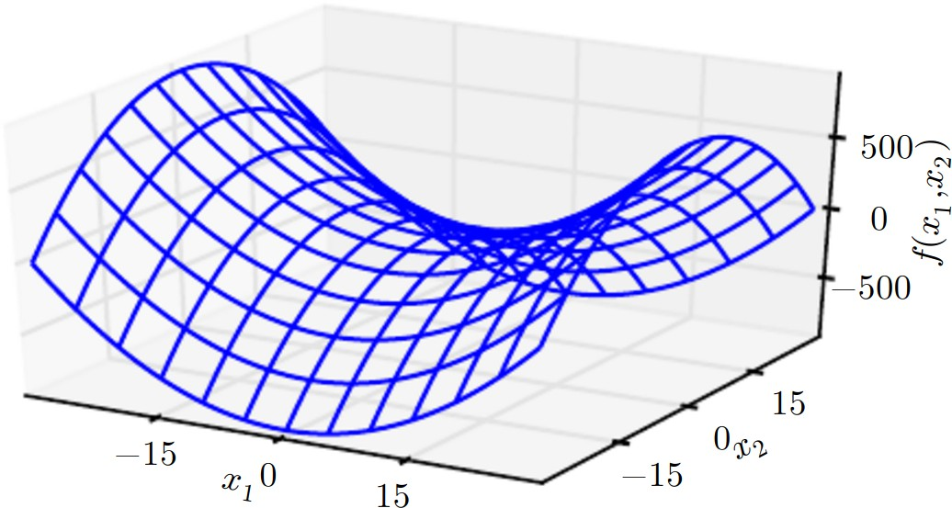
Saddle Points
Regularization Introduction
In addition to local minima, cost functions include saddle points
Figure 2: Saddle points, Source: Goodfellow et al., 2016
Gradients are very small around a saddle point

Slide 5
Gradients
Regularization Introduction
Cost function surface is unknown
We only know back-prop gradients of parameters θ:
⁾ Online w.r.t. a single instance (x ^{(i)}, y ^{(i)}):
gˆ = ∇_{θ} L(f (x ^{(i)}, θ), y ^{(i)})
}
Train (i) (i) (N) (N)
)
Batch of full training set D := (x , y ), . . . , (x , y ) :
N
1
Σ
(i) (i)
g = ∇ L(f (x , θ), y )
N
θ
i=1
}
(i) (i) (m) (m) Train
)
Mini-batch (x , y ), . . . , (x , y ) ⊂ D for m << N:
Σ
1
m
(i) (i)
gˆ = ∇ L(f (x , θ), y )
m
θ
i=1

Slide 6
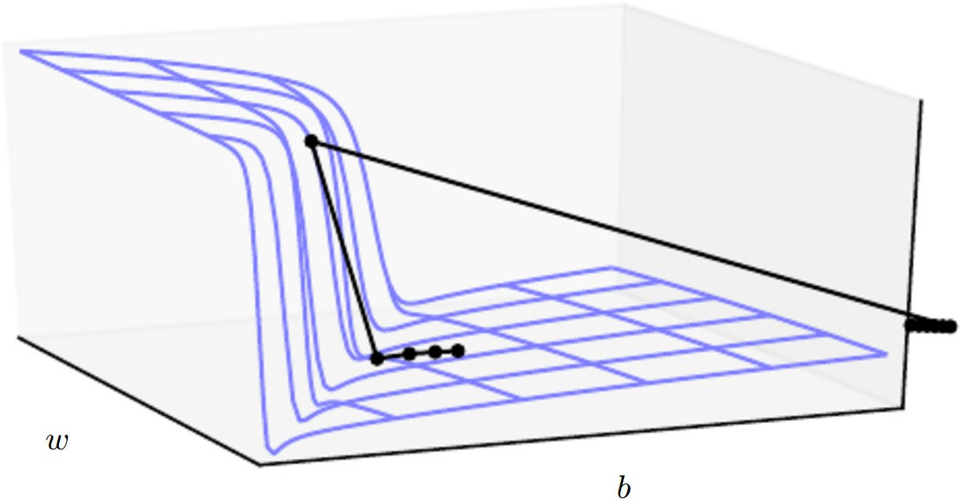
Stochastic Gradient Descent and Learning Rates
Regularization Introduction
We previously mentioned gradient descent θ ← θ − ϵgˆ
What is the learning rate/step size ϵ =?
Figure 3: Cliffs and Exploding Gradients, Source: Goodfellow et al., 2016
This lecture discusses methods that help converge at a minimum cost with the smallest amount of steps and time

Slide 7
Outline
Regularization Parameter Initializations
Introduction
Parameter Initializations
SGD and Momentum
Adaptive Learning Rates
6 / 19

Slide 8
Parameter Initializations
Regularization Parameter Initializations
Most approaches are simple and heuristic
It is important to break the symmetry between hidden units
Layer (1)
Layer (2)
x₁
W
(1)
1,1
_{a}(1) _{| h}(1)
1 1
W
(2)
W
(1)
1,1
_{a}(2) _{| h}(2)
y
(1)
1
(1)
1,2
b
1 1
W
2,1
(2)
2,1
x₂
_{a}(1) _{| h}(1)
W
W
(1)
(2)
1
2,2
2 2
b
(1)
2
b
Figure 4: What if initially W ⁽¹⁾ = W ⁽¹⁾, W ⁽¹⁾ = W ⁽¹⁾ and b⁽¹⁾ = b⁽¹⁾?
1,1 1,2 2,2 2,2 1 2
Biases set to heuristically-chosen constant and weights randomly
6 / 19

Slide 9
Parameter Initializations (II)
Regularization Parameter Initializations
Weights:
(A)
2
)
Gaussian Noise W ∼ N(0, σ )
i,j
⁾ Commonly used heuristic is the Normalized Initialization (Xavier):
s
^{s}
, +
!
(A)
6 6
W ∼ U −
i,j
NA + NA+1 NA + NA+1
Biases:
(L)
)
Output layer: argmin L(h , y¯)
_{b}(L)
⁾ Hidden layer: b^{(A)} := c, when for ReLU set c > 0 to avoid the ”Dead ReLU” phenomenon

Slide 10
Outline
Regularization SGD and Momentum
Introduction
Parameter Initializations
SGD and Momentum
Adaptive Learning Rates
8 / 19

Slide 11
Stochastic Gradient Descent (SGD)
Regularization SGD and Momentum
Algorithm 1: SGD of the k-th epoch
Require: Learning rate ϵ_{k} , Initial parameters θ
1: while stopping criterion not met do
}
(1) (1)
(m) (m)
2: Sample mini-batch: x , y , . . . , x , y
Σ
m
1
(i ) (i )
3: Estimate gradient: gˆ ← ∇ L(f (x ; θ), y )
m
ϴ
i =1
4: Apply gradient: θ ← θ − ϵ gˆ
Σ Σ
Converges if
∞ ∞
2
ϵ = ∞ and
ϵ < ∞
k
k=1 k=1 k
In practice, it is common to decay the learning rate:
(
1 − ϵ
k k
+ ϵ if k < τ
if k ≥ τ
ϵ_{k} =
τ
0
τ
τ
, where ϵ₀ >> ϵ_{τ}
ϵ_{τ}
8 / 19

Slide 12
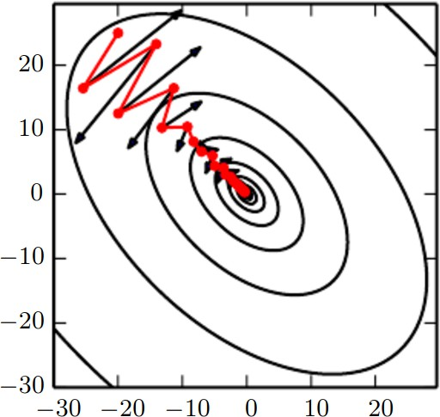
Momentum
Regularization SGD and Momentum
Figure 5: A quadratic loss with a poor conditioned Hessian; Black arrows: Gradient descent steps; Red line: Momentum correction, Source: Goodfellow et al., 2016

Slide 13
Momentum (II)
Regularization SGD and Momentum
Introduce a velocity term v per each parameter
Accumulate gradient steps in the velocity term
Update velocity in a moving average style with α ∈ [0, 1)
!
m
1
m
Σ
v ← αv − ϵ∇_{ϴ}
(i ) (i )
L f (x ; θ), y
i =1
Ultimately: θ ← θ + v
The step depends on the alignment of a sequence of gradients

Slide 14
Momentum (III)
Regularization SGD and Momentum
Algorithm 2: SGD of the k-th epoch with Momentum
Require: Learning rate ϵ_{k} , Initial parameters θ, Initial velocity v
1: while stopping criterion not met do
}
(1) (1) (m) (m)
2: Sample mini-batch: x , y , . . . , x , y
Σ
m
1
(i ) (i )
3: Estimate gradient: gˆ ← ∇ L(f (x ; θ), y )
m
ϴ
i =1
4: Update velocity: v ← αv − ϵgˆ
5: Apply gradient: θ ← θ + v
Commonly α ∈ {0.5, 0.9, 0.99}
Note: It might be useful to think momentum in terms of Newton
dynamics f (t) = ^{∂2} θ(t), f (t) = ∂ v (t), v (t) = ∂ θ(t)
∂t² ∂t ∂t
⁾ The force pushing weights downwards is −∇_{θ} J(θ).

Slide 15
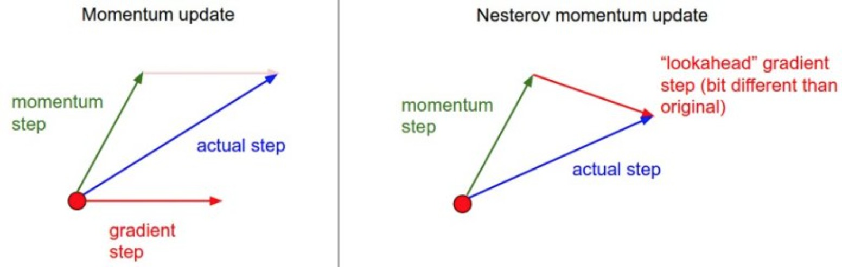
Nesterov Momentum
Regularization SGD and Momentum
Nesterov momentum adds a correction (look-ahead) factor to the standard velocity update
Figure 6: Nesterov momentum with a correction factor
Computes gradient at the updated weights:
!
m
1
m
Σ
v ← αv − ϵ∇_{ϴ}
(i ) (i )
L f (x ; θ + αv ), y
i =1

Slide 16
Nesterov Momentum (II)
Regularization SGD and Momentum
Algorithm 3: SGD of the k-th epoch with Nesterov Momentum
Require: Learning rate ϵ_{k} , Initial parameters θ, Initial velocity v
1: while stopping criterion not met do
}
(1) (1) (m) (m)
2: Sample mini-batch: x , y , . . . , x , y
3: Apply interim update: θ˜ ← θ + αv
Σ
m
~
1
(i )
(i )
4: Estimate gradient: gˆ ← ∇ L(f (x ; θ), y )
˜
m ϴ
i =1
5: Update velocity: v ← αv − ϵgˆ
6: Apply gradient: θ ← θ + v
Nesterov momentum is currently the most widely used momentum in Deep Learning libraries and is provided by Tensorflow and Theano

Slide 17
Outline
Regularization Adaptive Learning Rates
Introduction
Parameter Initializations SGD and Momentum
Adaptive Learning Rates
14 / 19

Slide 18
Adagrad
Regularization Adaptive Learning Rates
Strongly decrease learning rate for high gradients
Rapid progress in gently sloped directions
Algorithm 4: Adagrad learning rate adaptation
Require: Learning rate ϵ_{k} , Initial parameters θ, Small constant δ
1: while stopping criterion not met do
}
(1) (1) (m) (m)
2: Sample mini-batch: x , y , . . . , x , y
Σ
m
1
(i ) (i )
3: Estimate gradient: gˆ ← ∇ L(f (x ; θ), y )
m
ϴ
i =1
4: Accumulate gradients
5: Apply gradient: θ ← θ
r ← r + gˆ ⊙ gˆ
— | ϵ _{δ +} √_{r} ⊙ gˆ
14 / 19

Slide 19
RMSProp (Root-mean square propagation)
Regularization Adaptive Learning Rates
As √r increases in Adagrad ^{√є} becomes too small
r
RMSProp introduces an exponentially decaying average of the gradient history
Algorithm 5: RMSProp learning rate adaptation
Require: Learning rate ϵ_{k} , Initial parameters θ, Small constant δ, Decay ρ
1: while stopping criterion not met do
}
(1) (1) (m) (m)
2: Sample mini-batch: x , y , . . . , x , y
Σ
m
1
(i ) (i )
3: Estimate gradient: gˆ ← ∇ L(f (x ; θ), y )
m
ϴ
i =1
4: Accumulate gradients r ← ρr + (1 − ρ)gˆ ⊙ gˆ
5: Apply gradient: θ ← θ −
є
⊙ gˆ
√
δ+ r

Slide 20
RMSProp with Nesterov Momentum
Regularization Adaptive Learning Rates
Adaptive learning rate methods can be combined with momentum
Algorithm 6: RMSProp with Nesterov Momentum
Require: Learning rate ϵ_{k} , Initial parameters θ, Small constant δ, Decay
ρ, Momentum α
1: while stopping criterion not met do
}
(1) (1) (m) (m)
2: Sample mini-batch: x , y , . . . , x , y
3: Apply interim update: θ˜ ← θ + αv
Σ
m
~
1
(i )
(i )
4: Estimate gradient: gˆ ← ∇ L(f (x ; θ), y )
˜
m ϴ
i =1
5: Accumulate gradients r ← ρr + (1 − ρ)gˆ ⊙ gˆ
ϵ
6: Update velocity: v ← αv −
⊙ gˆ
δ + √r
7: Update parameter θ ← θ + v

Slide 21
Adam (Adaptive Moment)
Regularization Adaptive Learning Rates
Algorithm 7: Adam (Suggested ϵ = 10⁻³, ρ₁ = 0.9, ρ₂ = 0.99, δ = 10⁻⁸)
Require: Learning rate ϵ_{k} , Initial parameters θ, Small constant δ, Decay rates ρ₁, ρ₂
1: s = 0, r = 0
2: t = 0
3: while stopping criterion not met do
}
(1) (1) (m) (m)
4: Sample mini-batch: x , y , . . . , x , y
Σ
m
1
(i ) (i )
5: Estimate gradient: gˆ ← ∇ L(f (x ; θ), y )
m
ϴ
i =1
6: t ← t + 1
7: Update gradient accumulator s ← ρ₁s + (1 − ρ₁)gˆ
8: Correct gradient accumulator sˆ ←
s
t
1−ρ₁
9: Update squared gradient accumulator r ← ρ₂r + (1 − ρ₂)gˆ ⊙ gˆ
10: Correct squared gradient accumulator rˆ ←
r
t
1−ρ₂
11: Update θ ← θ − ϵ
sˆ
δ+rˆ

Slide 22
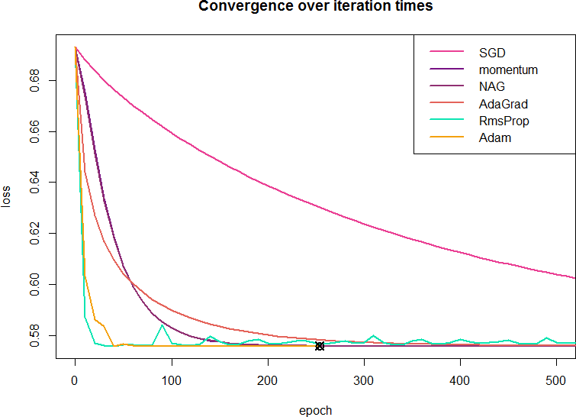
Comparing Various Optimization Approaches
Regularization Adaptive Learning Rates
Figure 7: Optimizing a logistic regression model, Source: gmo.jp

